Slide 2
Mixed Reality with Xamarin and Azure Spatial Anchors
Dhave P. Dayao
Senior Xamarin Developer / XAM Consulting
https://xambuddy.github.io/

Slide 3
What is Xamarin?

Slide 4
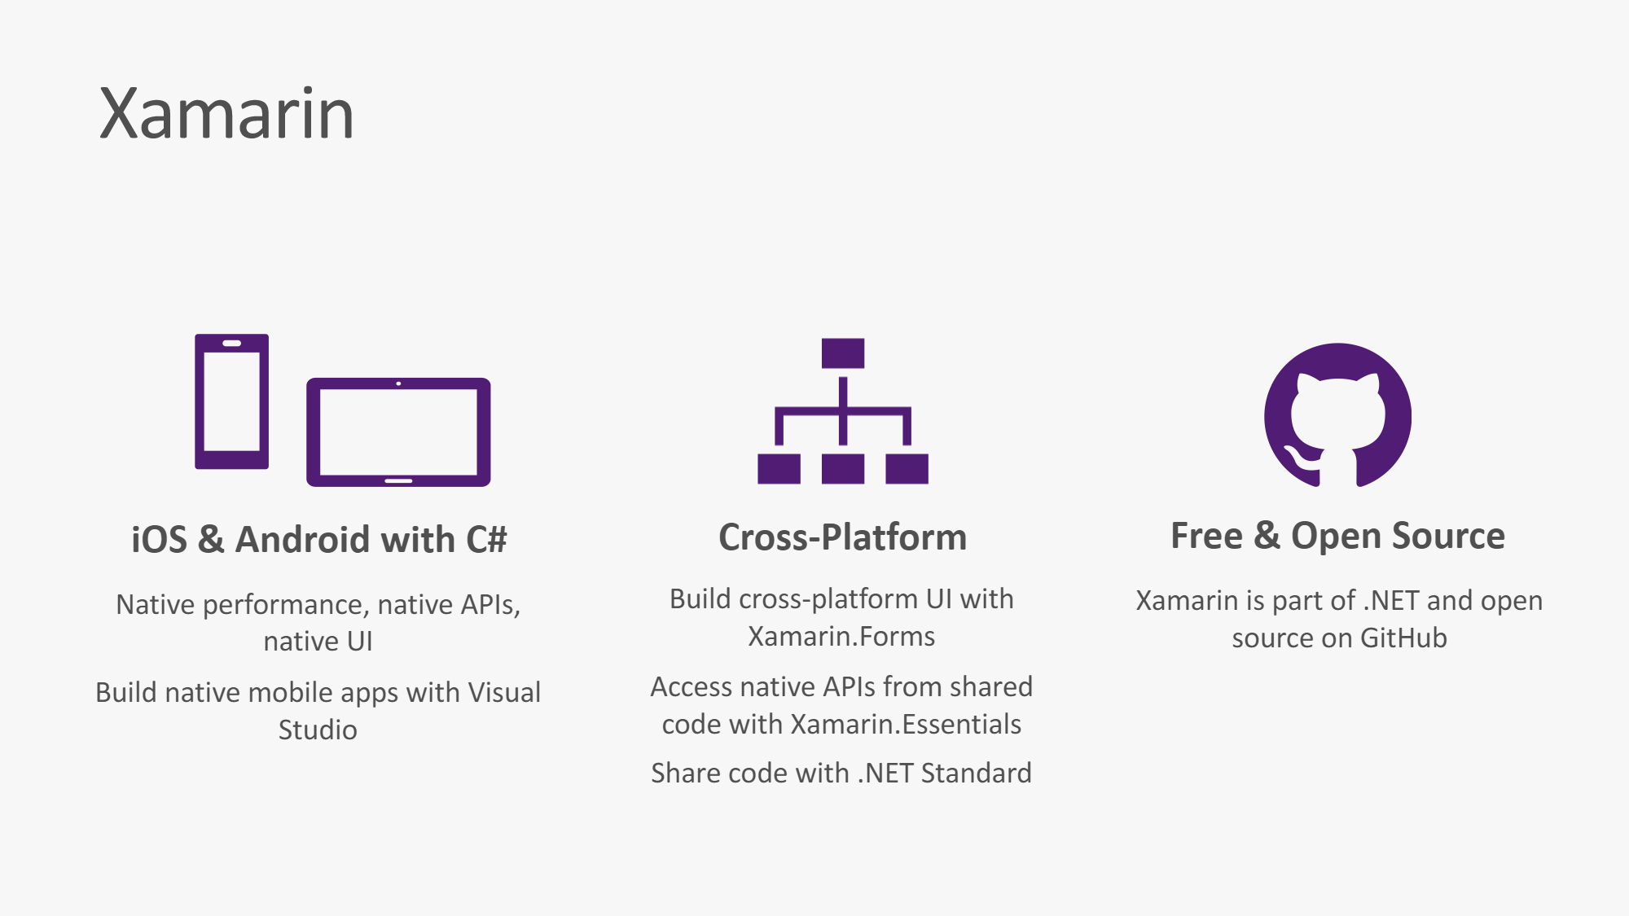

Slide 5
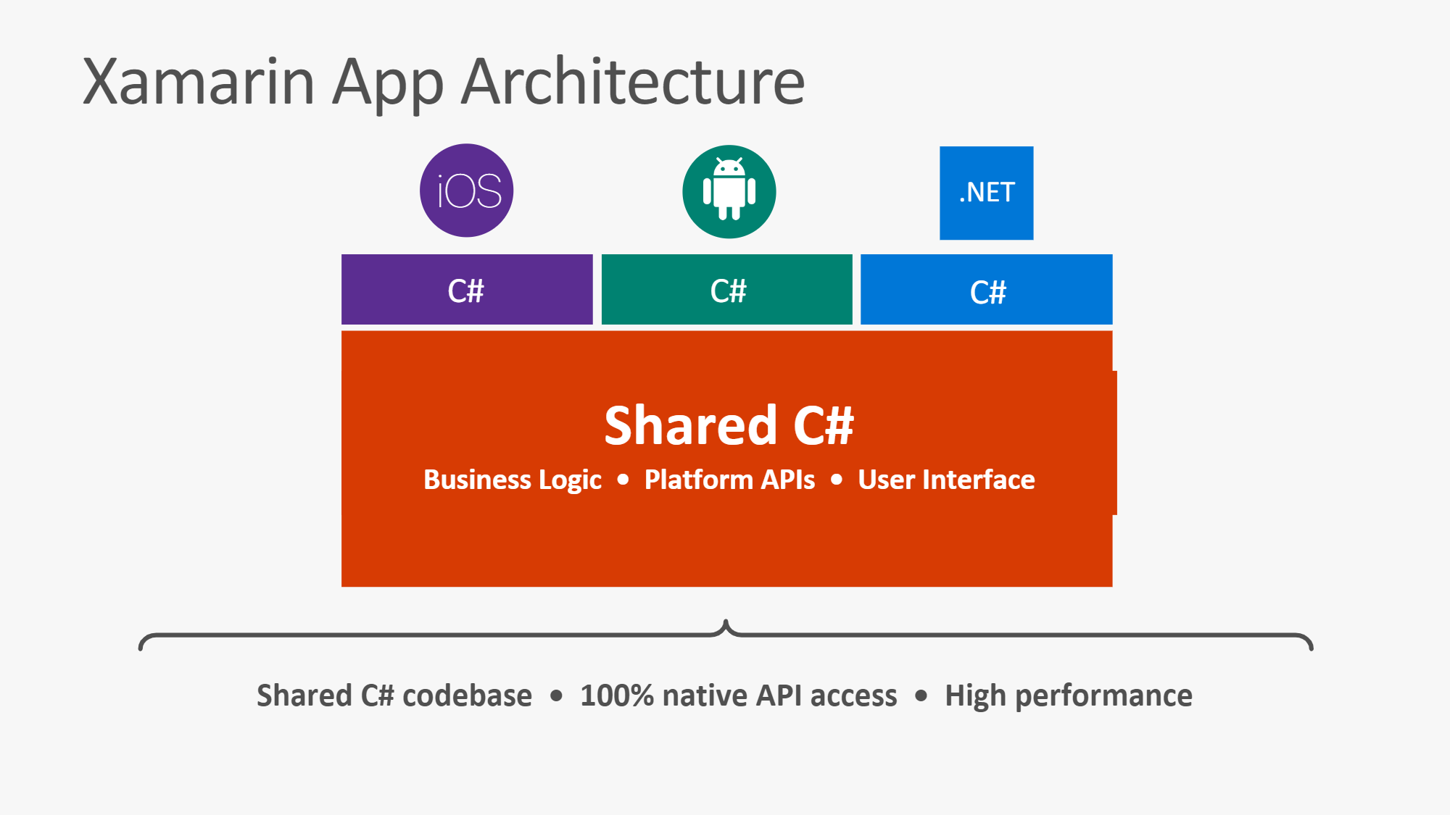

Slide 6
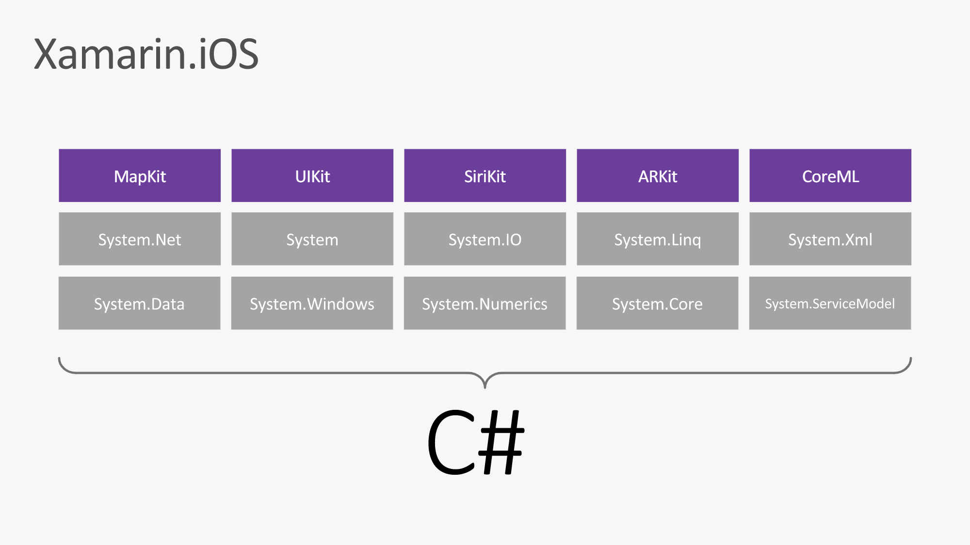

Slide 7
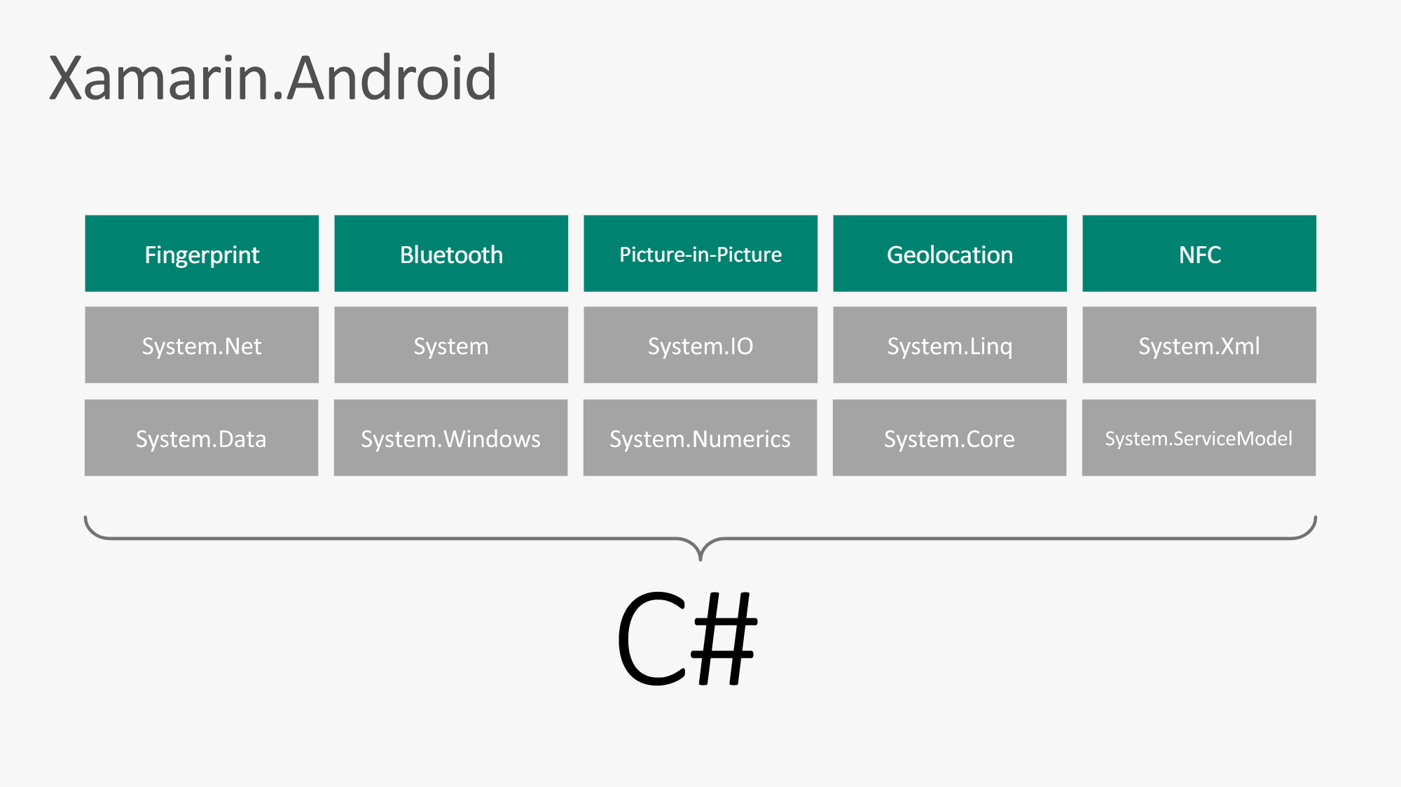

Slide 8
What is Augmented Reality?

Slide 9
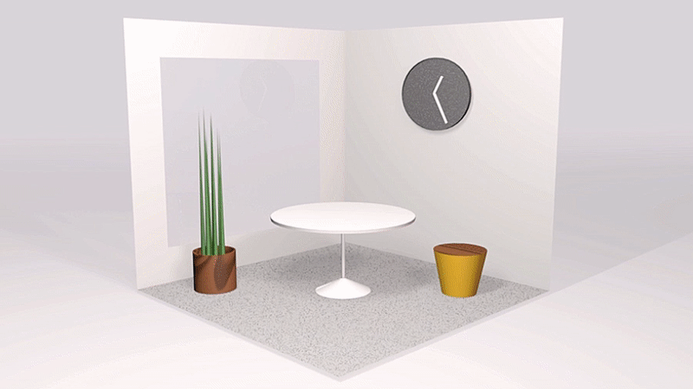
Feature being leveraged is Camera + Augmented Reality
Objects are virtually drawn on screens on real world coordinates + spatial location
Native :
ARKit/SceneKit – iOS
ARCore/SceneForm - Android

Slide 10
What is Azure Spatial Anchors?

Slide 11
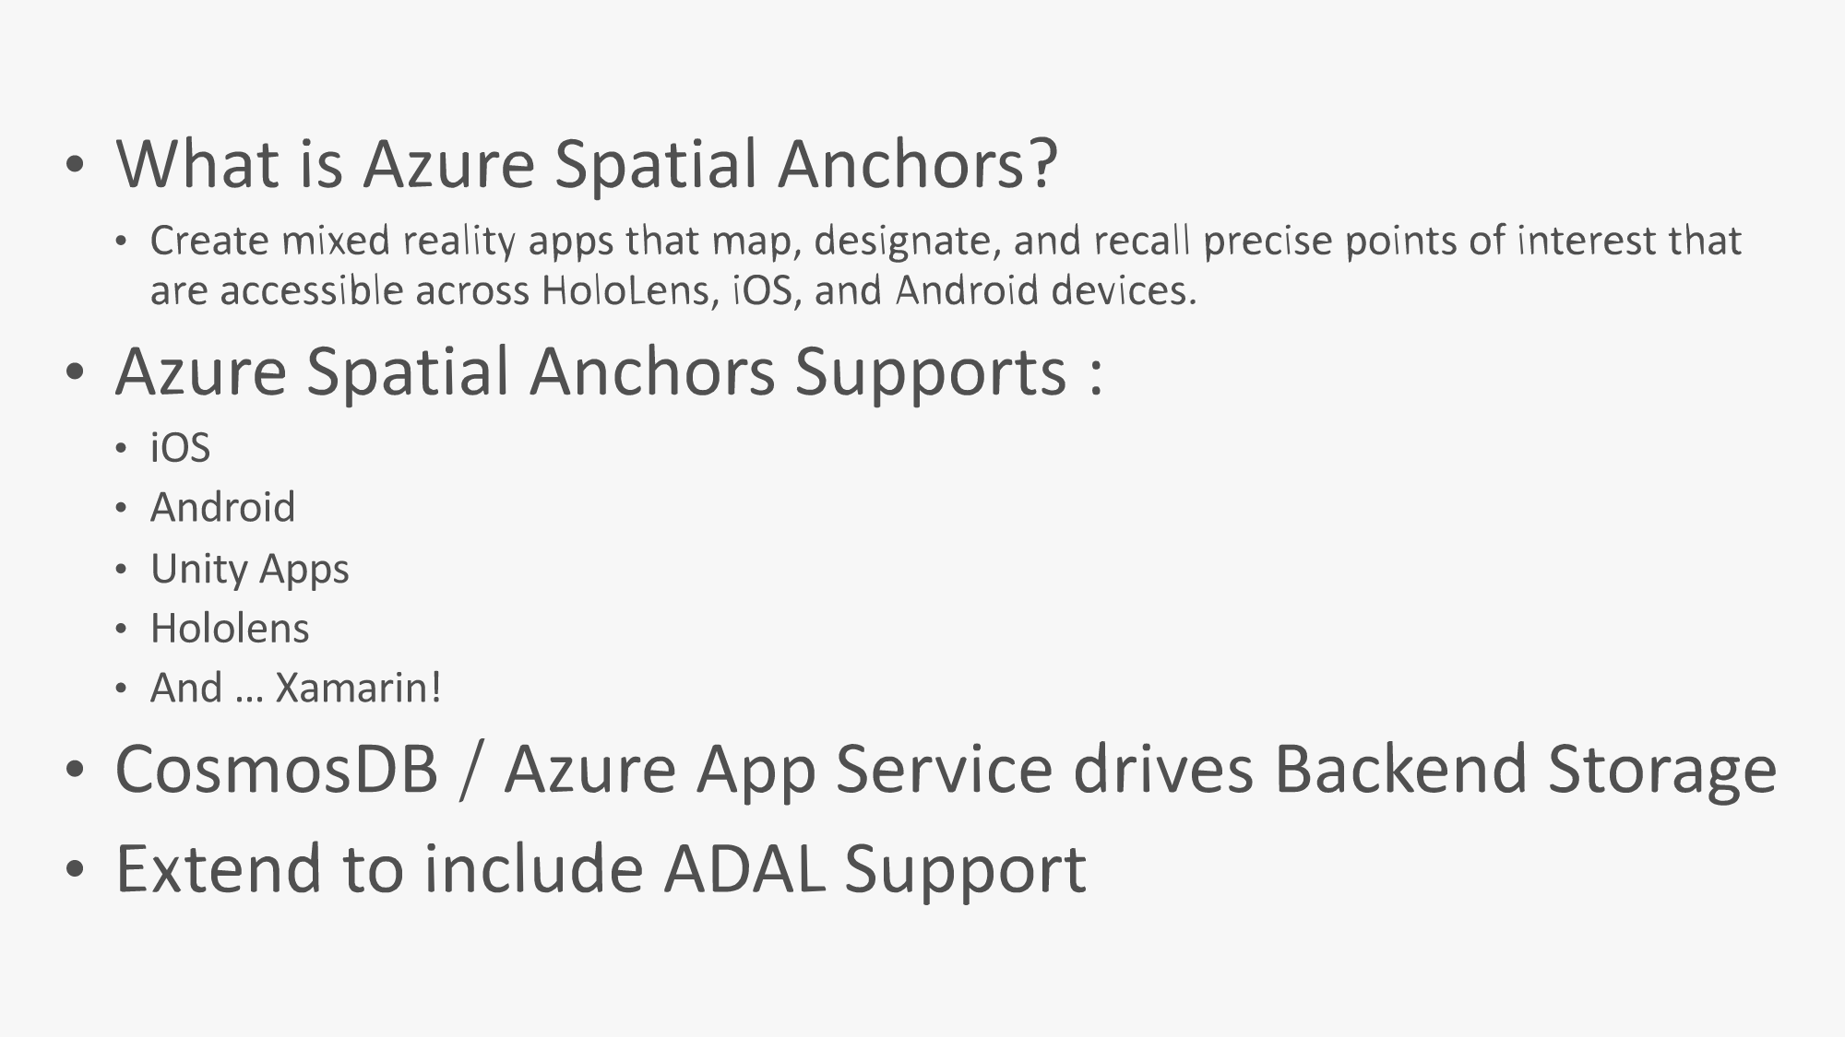

Slide 12
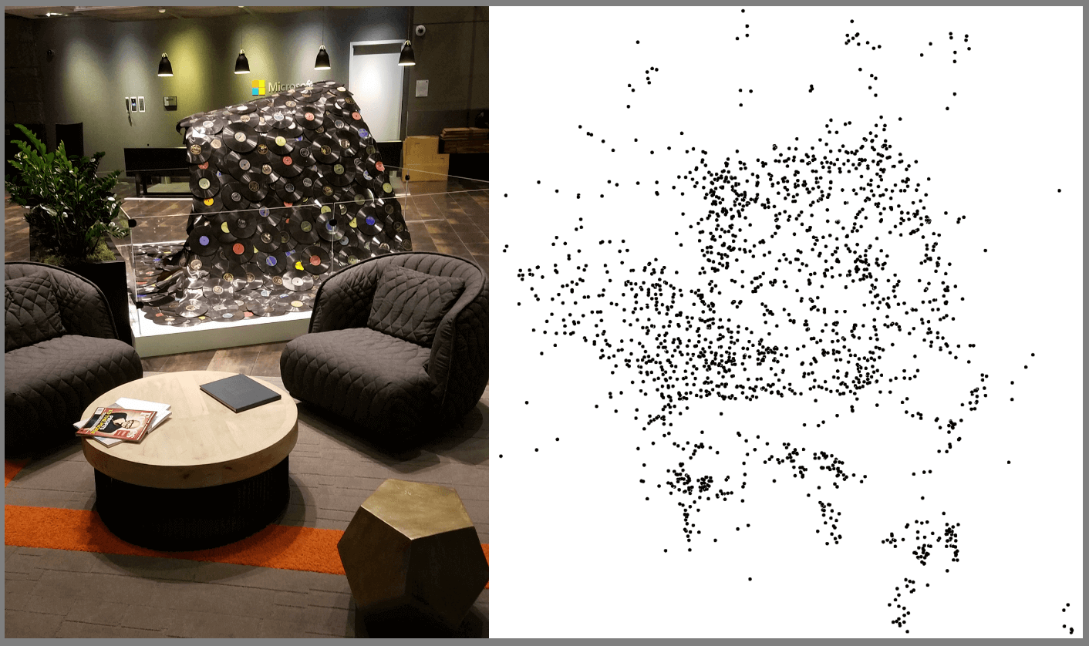
Point Cloud

Slide 13
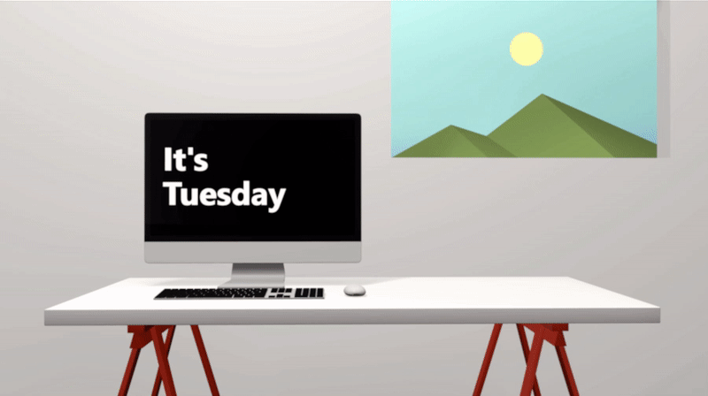
Example use cases enabled by Spatial Anchors
Multi-user experiences
Notes:
Multi-user experiences. Spatial Anchors makes it easy for people in the same place to participate in multi-user mixed reality applications. For example, two people can start a game of mixed reality chess by placing a virtual chess board on a table. Then, by pointing their device at the table, they can view and interact with the virtual chess board together.

Slide 14
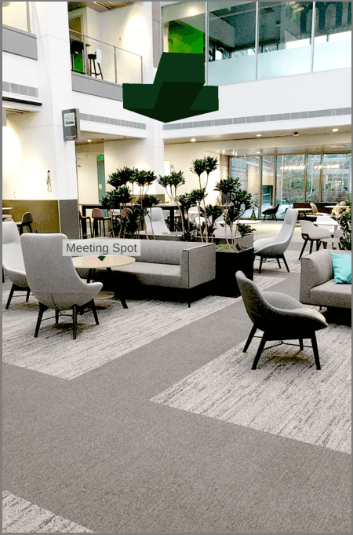
Example use cases enabled by Spatial Anchors
Way Finding
Notes:
Way-finding. Developers can also connect Spatial Anchors together creating relationships between them. For example, an app may include an experience that has two or more points of interest that a user must interact with to complete a task. Those points of interest can be created in a connected fashion. Later, when the user is completing the multi-step task, the app can ask for anchors that are nearby the current one to direct the user towards the next step in the task.

Slide 15
Example use cases enabled by Spatial Anchors
Persisting virtual content in the real-world
Notes:
Persisting virtual content in the real-world. An app can let a user place a virtual calendar on a conference room wall, that people can see using a phone app or a HoloLens device. In an industrial setting, a user could receive contextual information about a machine by pointing a supported device camera at it.

Slide 16
Supported Devices

Slide 17
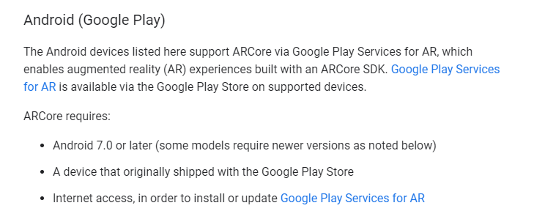
Link: https://developers.google.com/ar/discover/supported-devices

Slide 18
How to Start?

Slide 19
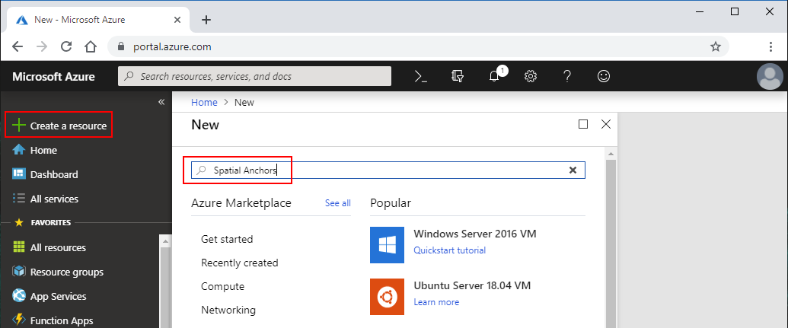
Create a Spatial Anchors resource

Slide 20
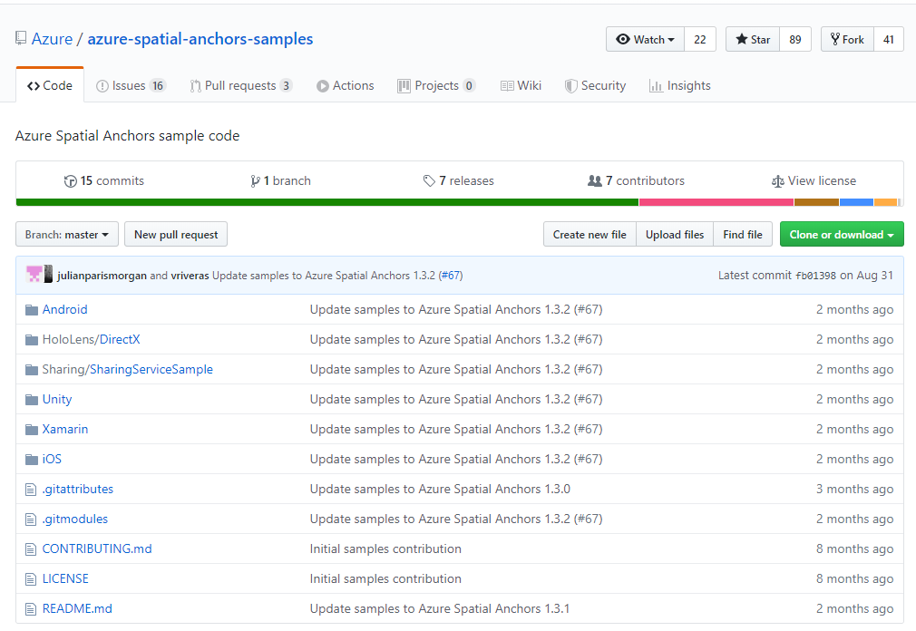
Download samples:
https://github.com/Azure/azure-spatial-anchors-samples

Slide 21
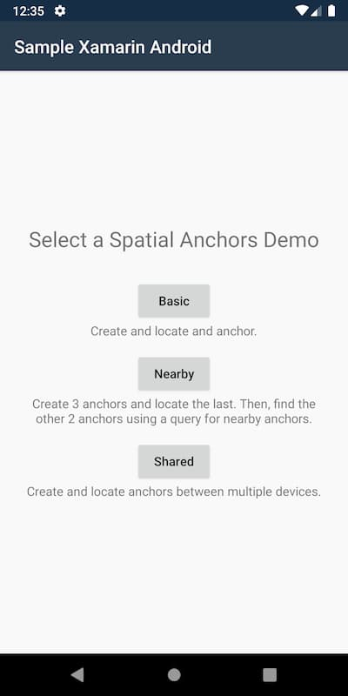
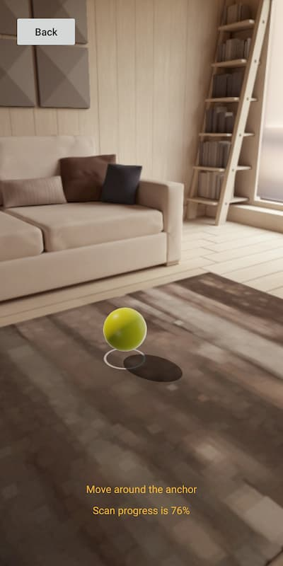
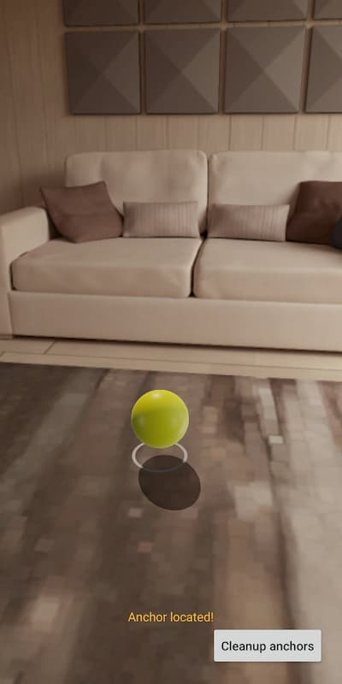
Run on your Device

Slide 22
Puzzle Anchors Hunt! Code : https://github.com/xambuddy/PuzzleAnchorsHunt

Slide 23
Admin App

Slide 24
Player App

Slide 25
Admin App

